Slide 1



Module 1
Understanding & Responding to Radicalization
ONLINE SYMPOSIUM
MODULE 6 PRESENTATION
ERASMUS+ PROJECT 2024-1-FR02-KA220-YOU-000244094
Funded by the European Union. Views and opinions expressed are however those of the author(s) only and do not necessarily reflect those of the European Union or the European Education and Culture Executive Agency (EACEA). Neither the European Union nor EACEA can be held responsible for them.

Slide 2
Introduction
To respond to radicalization, one must first understand radicalization (Dive In Consortium, 2021)
The benefits of eduLARPs in simulating extremes in a safe environment (Peterson & Vanek, 2016)
Creation of a complete, original blackbox eduLARP specifically for the „Not Just a Game” project, based on experiential learning (Kolb, 2014)
Target Groups
Sport Coaches
Youth Workers
Young people at risk of being radicalized

Slide 3
Learning Outcomes
Knowledge | Skills | Competences
Name the triggers and levels of radicalization | Point out concrete examples of radicalization at different levels | Write their thoughts, opinions and examples proactively and cooperatively
Discover the way radicalization operates in fan culture | Assess the practical implications of radicalization among fans | Role-play characters they have created themselves
Relate to the effects of radicalization emotionally | Identify signs of violent radicalization in the field of sports | Estimate the extent of radicalization in an individual or group

Slide 4
Training Content
Full 4-hour workshop (indicative times to the right)
Requires facilitator
Divided into 3 subchapters:
  Sub Chapter 1.1: Briefing
  Sub Chapter 1.2: EduLARP
  Sub Chapter 1.3: Debriefing
For 9-30 participants + facilitator
Requirements: one large room/area, choice of grassroots sports to engage in quick matches
Briefing | EduLARP | Debriefing
Min 20’ | Min 40’ | Min 20’
Suggested 60’ | Suggested 90’ | Suggested 60’
Max 75’ | Max 150’ | Max 75’

Slide 5
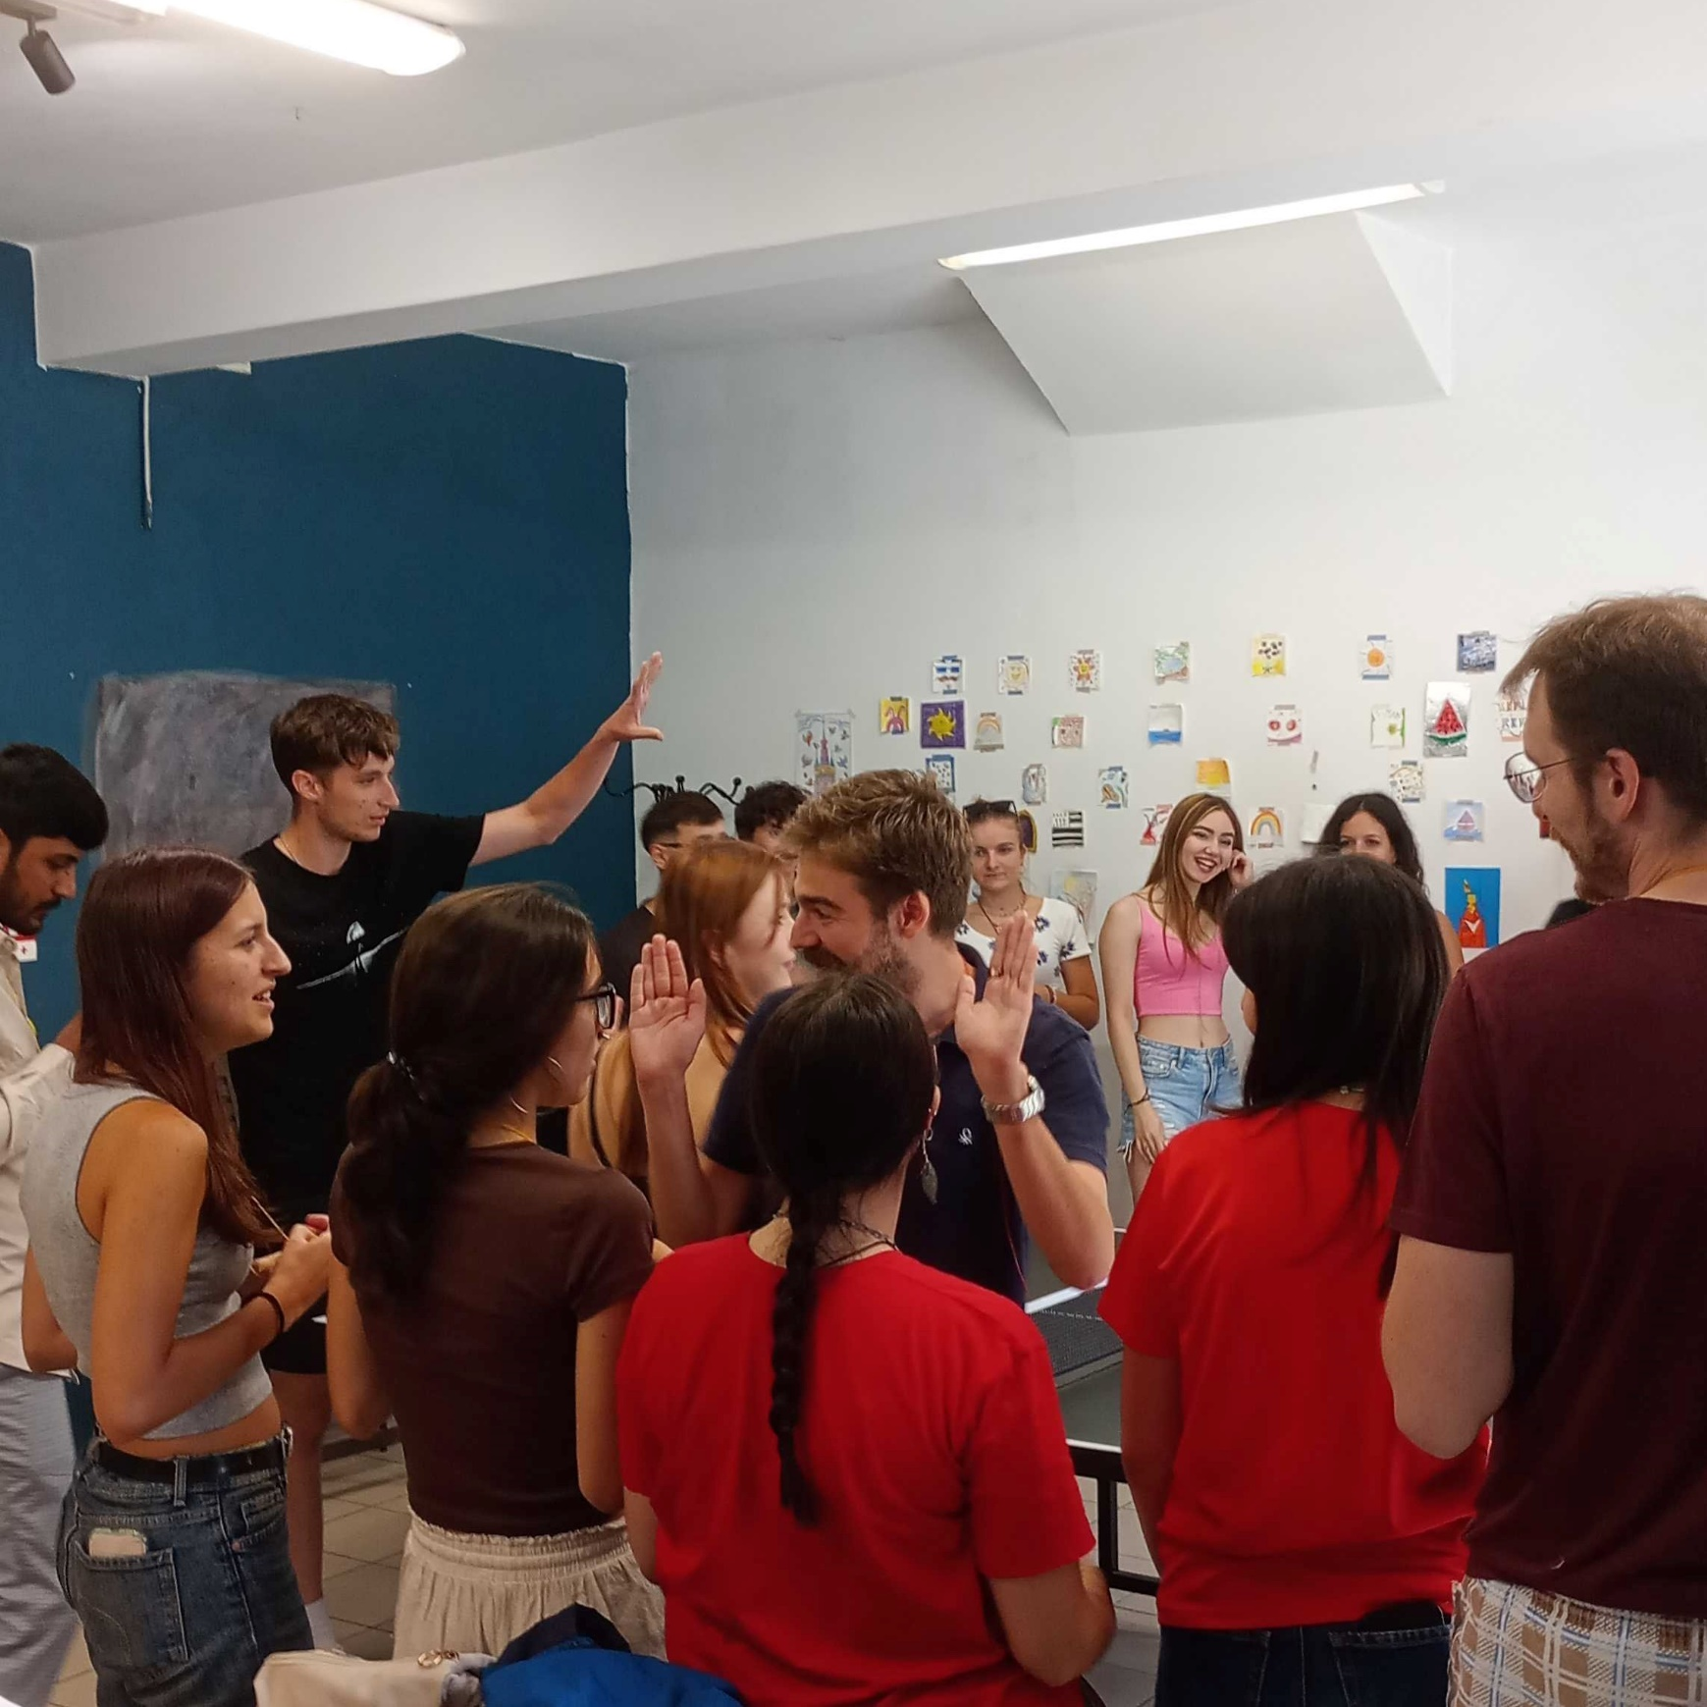
Sub Chapter 1.1:
Briefing
NOTE:
To change images on this slide, select a picture and delete it. Then click the Insert Picture icon
in the placeholder to insert your own image.
Theory & Practical Activity

Slide 6
Briefing
Theory
Practical activity
Presentation (5’): Moghaddam’s model of “Staircase Terrorism” & the 3N model of radicalization leading to violence.
World Café (25’): Participants separate into groups and discuss the theory and write down examples from their everyday life, as a participatory exercise
Presentation of the methodology (10’): Explain what eduLARP is
Explanation of the process & rules (10’): Prepare participants to participate in the eduLARP
Character Workshop (10’): Participants create their characters for the eduLARP („Fans” or „Athletes”)

Slide 7
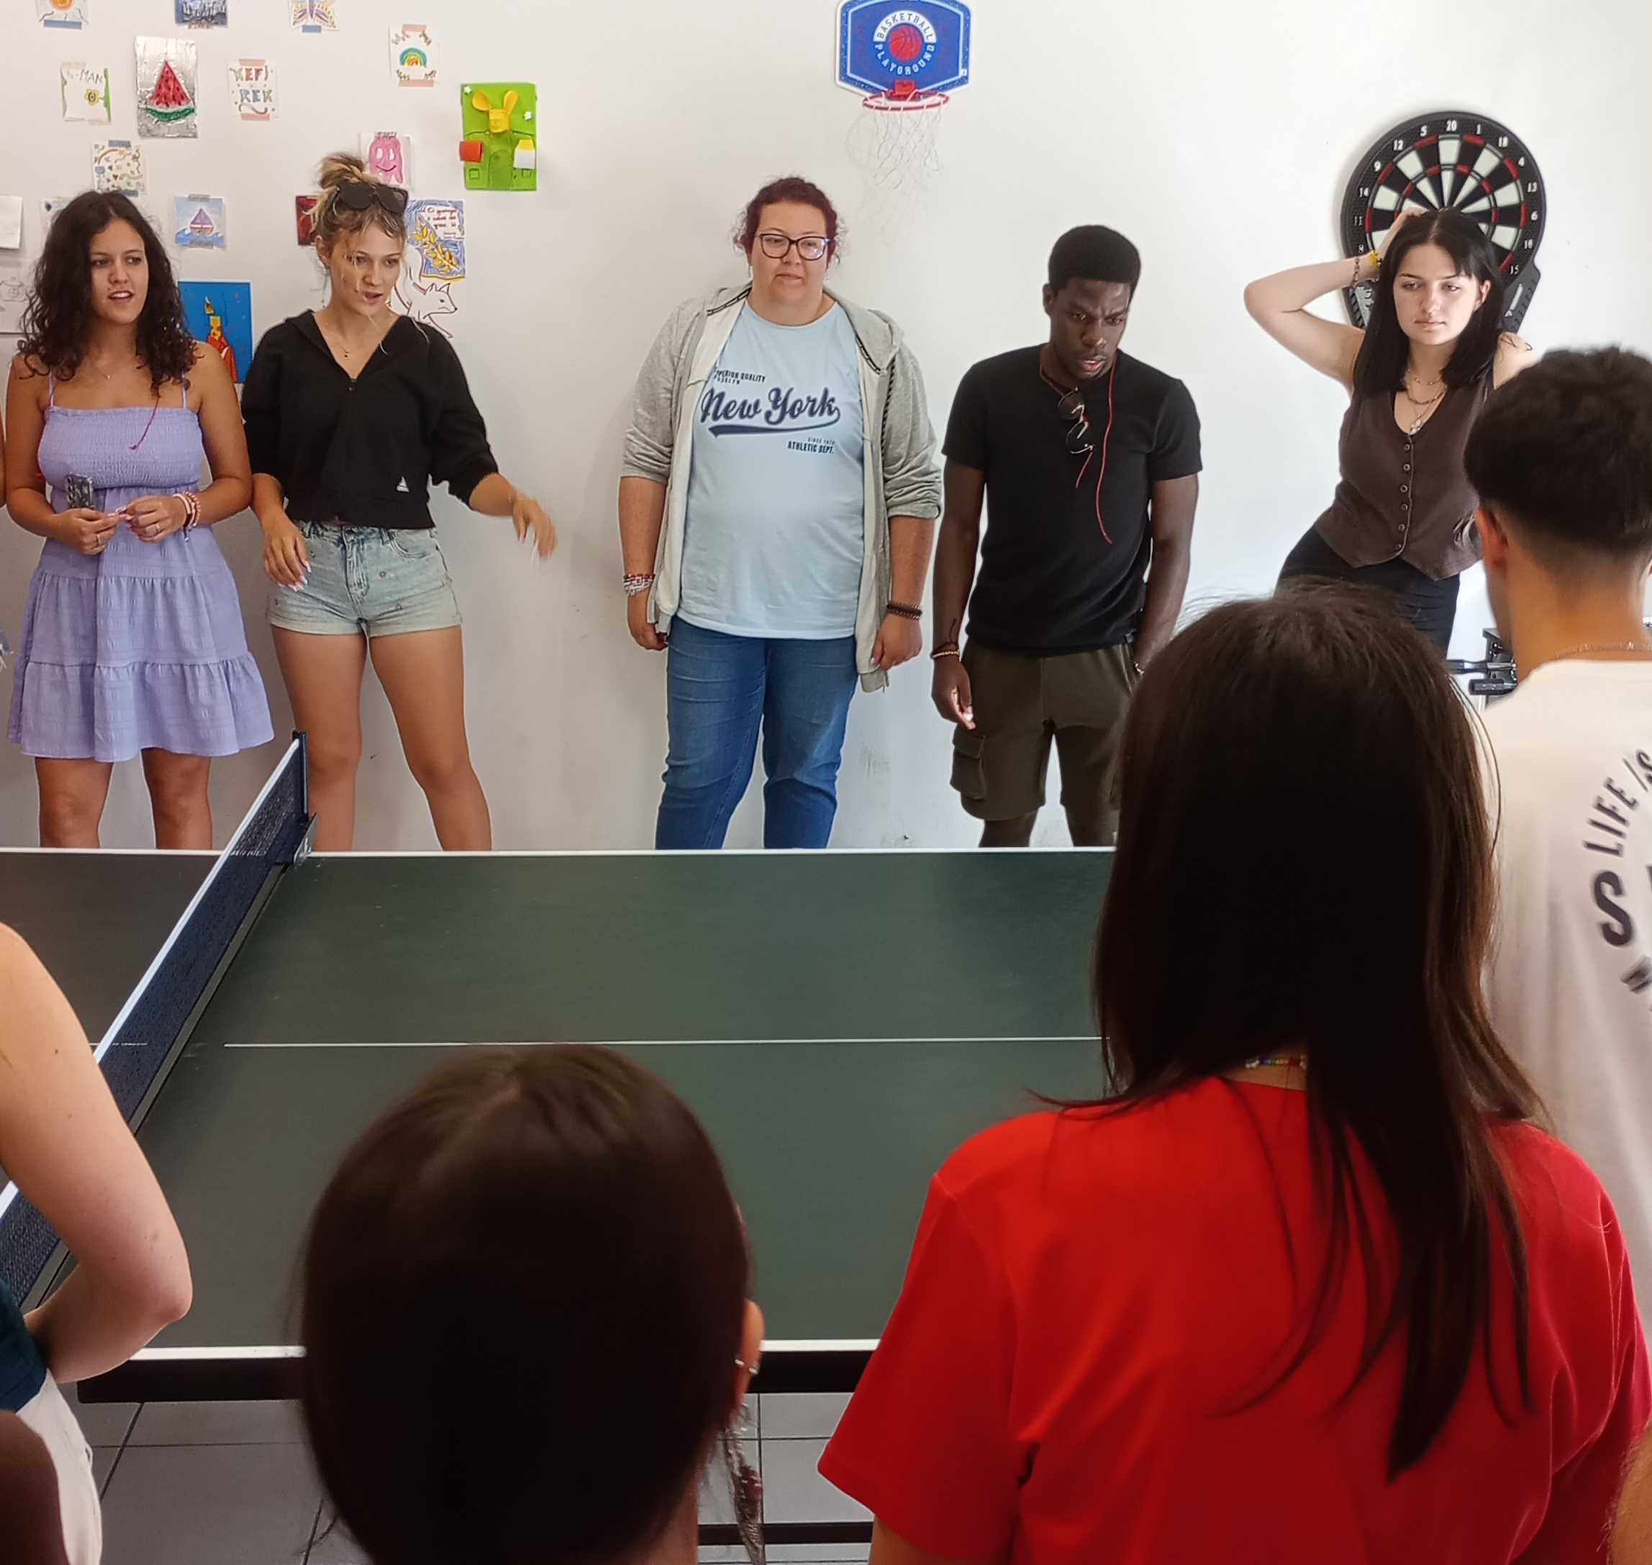
Sub Chapter 1.2:
EduLARP
NOTE:
To change images on this slide, select a picture and delete it. Then click the Insert Picture icon
in the placeholder to insert your own image.
Theory & Practical Activity

Slide 8
EduLARP
Theory
Practical Activity
Simulation of the violent culture arounding sport competitions
  Separation into 3 competing sports teams and their fans.
  Sports Teams engage in simple, quick 5-10’ matches based on a grassroots sport, depending on the available facilities
  „Fighting” mechanics: Participants simulate the violence of fans safely using intuitive mechanics of determining the outcome
Timeframe of the eduLARP:
  Out on the Tour! (10’)
  First Match (10’)
  Hanging Out (20’)
  Second Match (10’)
  Hanging Out Again (20’)
  Third Match (10’)
  Final Results & Awards (10’)

Slide 9
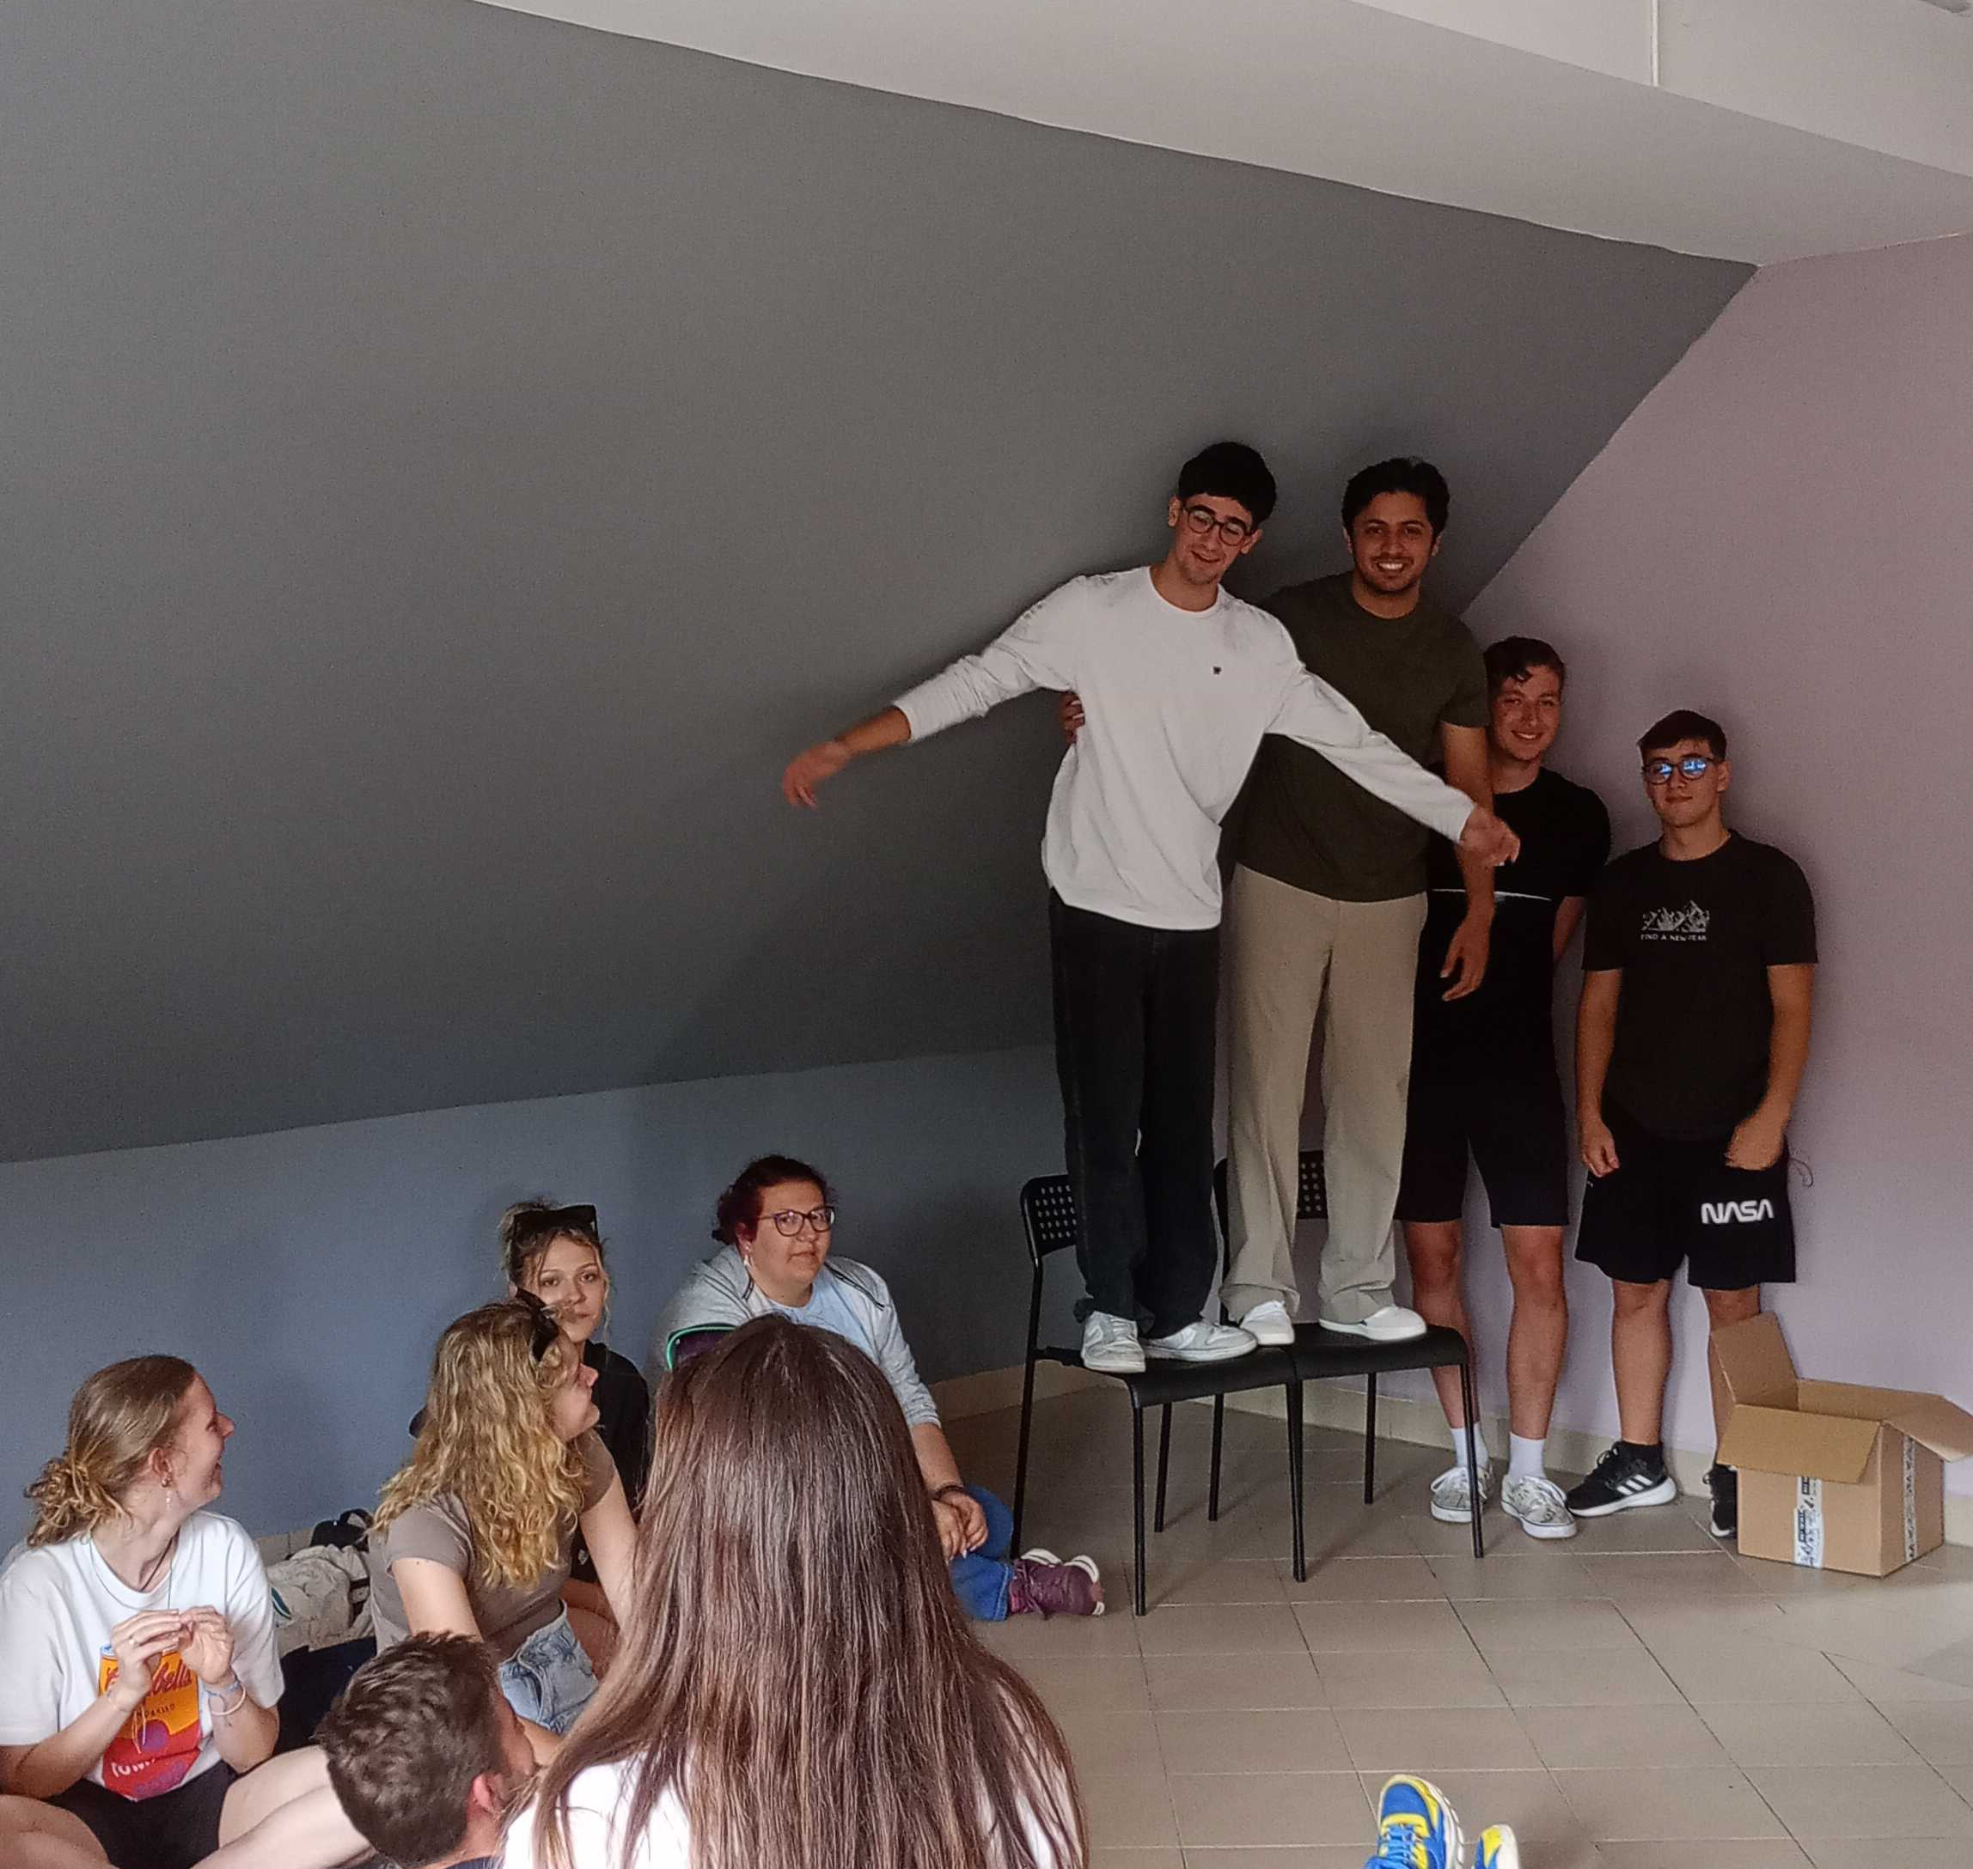
Sub Chapter 1.3:
Debriefing
NOTE:
To change images on this slide, select a picture and delete it. Then click the Insert Picture icon
in the placeholder to insert your own image.
Theory & Practical Activity

Slide 10
Debriefing
Theory
Practical Activity
Deroling to get out of the character, and debriefing to reflect on the experience
Managing Bleed and specifically Bleed Out (feelings of the character affecting the player)
Conclusion of the activity and making sure the learning outcomes are achieved
Timeframe of the eduLARP:
  Deroling (5’): getting out of the character
  Revisiting Theory (10’): Presenting the model of the briefing again, now with the added experience of the eduLARP
  Debriefing (30’): According to the snowball method, of pairs – small groups – large group.

Slide 11
Resources & References
Resources
References
Regarding LARPs and limits: https://nordiclarptalks.org/inclusion-in-larp-between-challenge-and-the-experience-of-limits-bjorn-butzen/
Advice for larp organizers: https://nordiclarp.org/2016/04/29/chamber-larps-audience-problem/
Examples of Blackbox LARPs: https://www.b-ok.de/larp-design/
Dive In Consortium (2021). DIVE IN - Dip Beyond Your Reality: The Manual for Educators and Youth Workers on EduLARP Methodology. Krakow, Poland.
Peterson, A., & Vanek, A. (2016). Live action role-playing (LARP): Insight into an underutilized educational tool. In K. Schrier, Learning, Education and Games (pp. 219-240). ETC Press.
Kolb, D. A. (2014). Experiential learning: Experience as the source of learning and development. FT Press.

