Slide 1




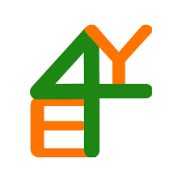




NOT
JUST
COUNTERING RADICALISATION THROUGH A SPORTS INTERVENTION
A GAME
ERASMUS PROJECT 2024-1-FR02-KA220-YOU-000244093

Slide 2

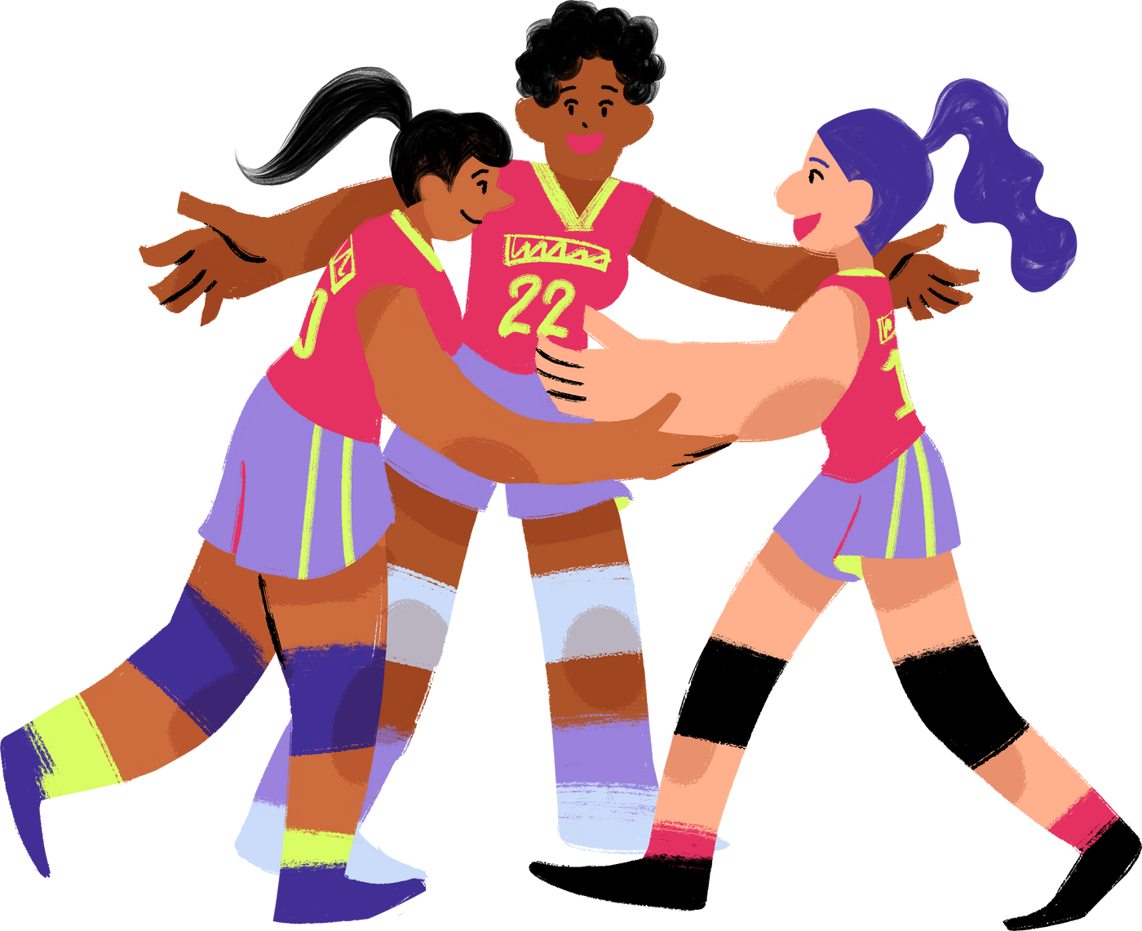
MODULE 3:
INCLUSIVE & INTERCULTURAL ENVIRONMENTS
THROUGH SPORT
CSS Târgu Jiu, Romania – Adela VLADOIU
This module focuses on how sport can be used as a tool for social inclusion and intercultural learning among young people, coaches and youth workers.

Slide 3

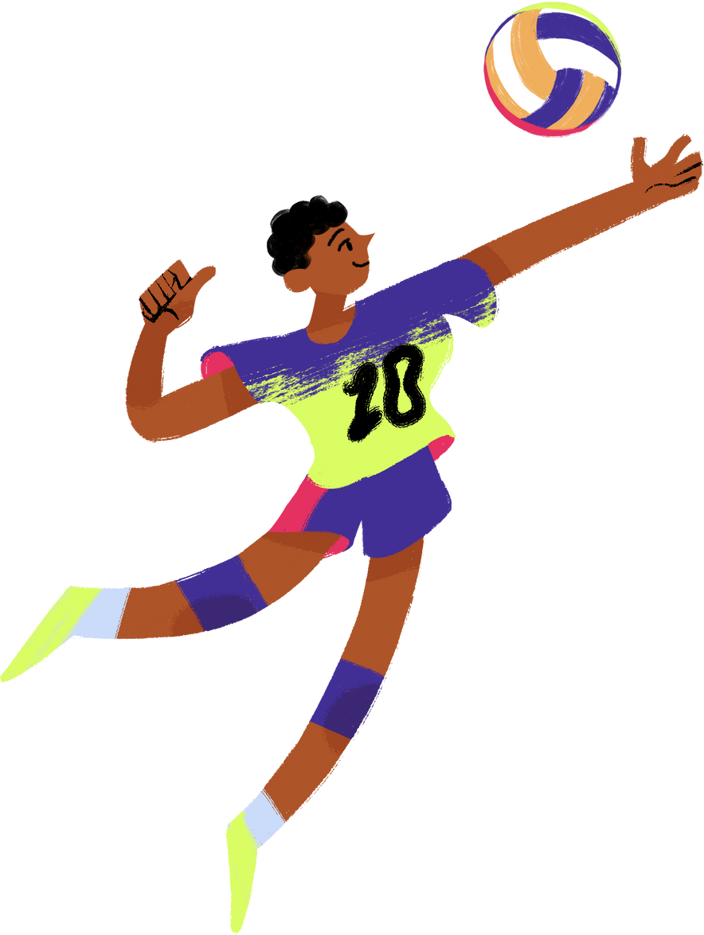
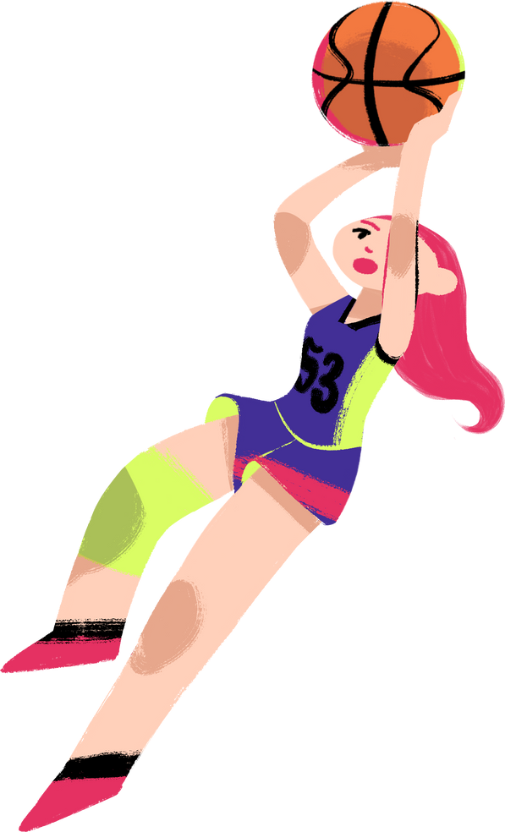
Aim & Target Group
  The main aim of Module 3 is to help participants create inclusive and empathetic environments in sport, where diversity is valued and everyone feels they belong. It is designed for youth workers, coaches and educators working with young people from different backgrounds.
  Objectives:
  Promote social inclusion through sport
  Develop intercultural competences
  Build safe and empathetic spaces

Slide 4

Structure of the Modul
01
Social inclusion through sport
02
Developing intercultural competencies through sport
03
Building a safe, inclusive and empathetic space
Thynk Unlimited

Slide 5
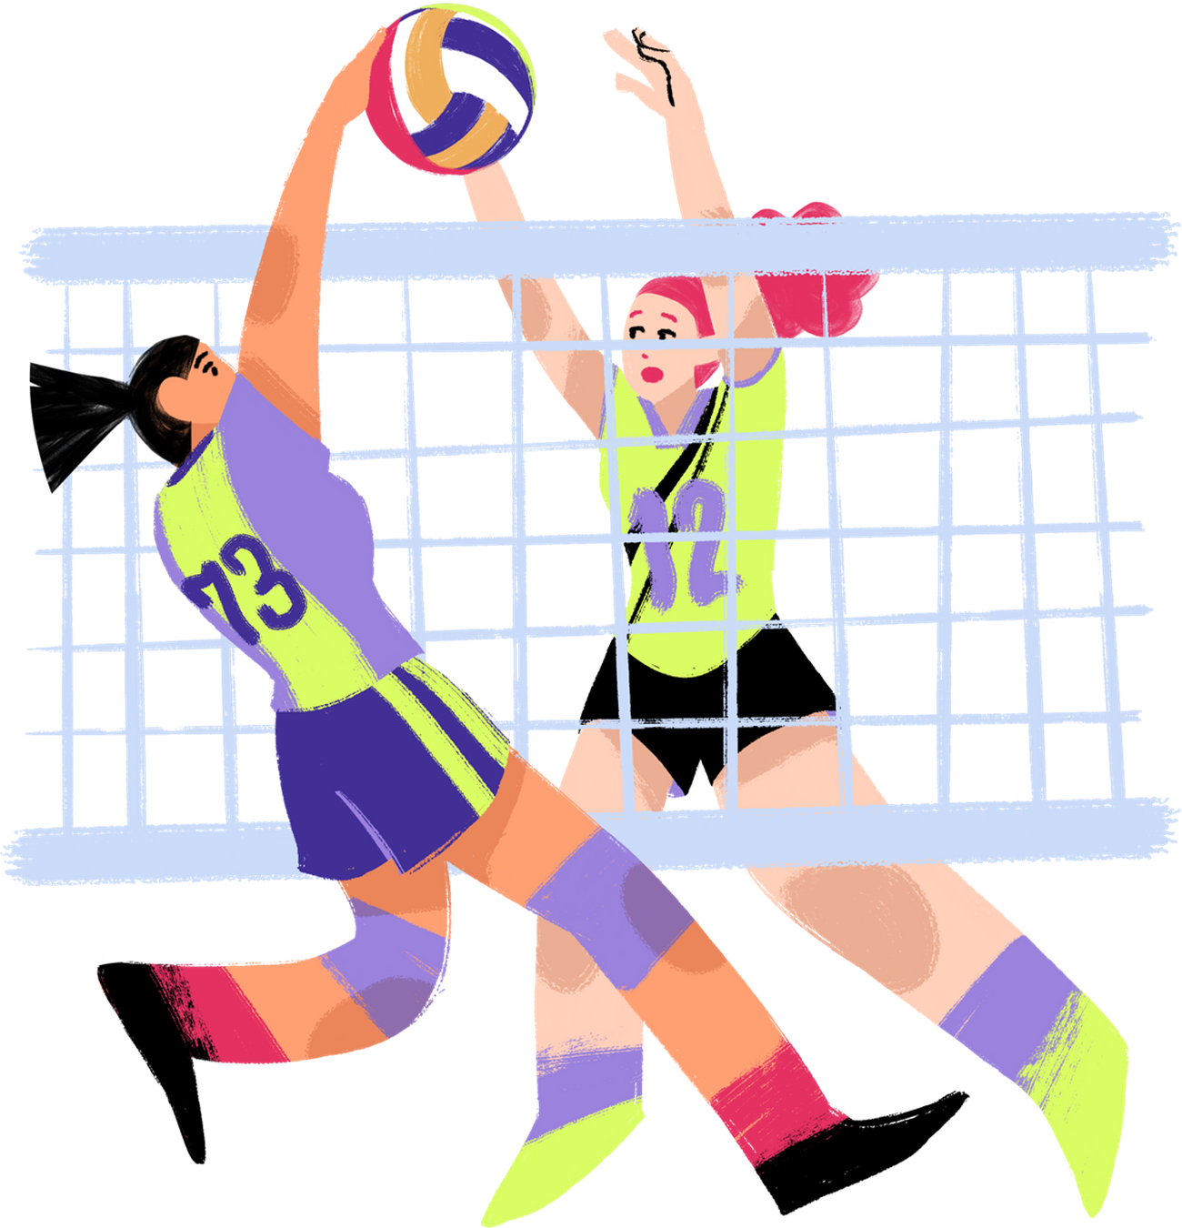
Short Overview of Each Chapter
In Chapter 3.1, we explore inclusion through storytelling and practical activities, showing how small actions can change group dynamics and make everyone feel part of the team.
Chapter 3.2 develops intercultural competences. Participants analyze scenarios of cultural misunderstandings and learn strategies for communication and mediation in sports contexts.
In Chapter 3.3, we focus on creating safe and empathetic spaces — through group reflection and cooperative exercises, we highlight the values of trust, respect and active listening.

Slide 6
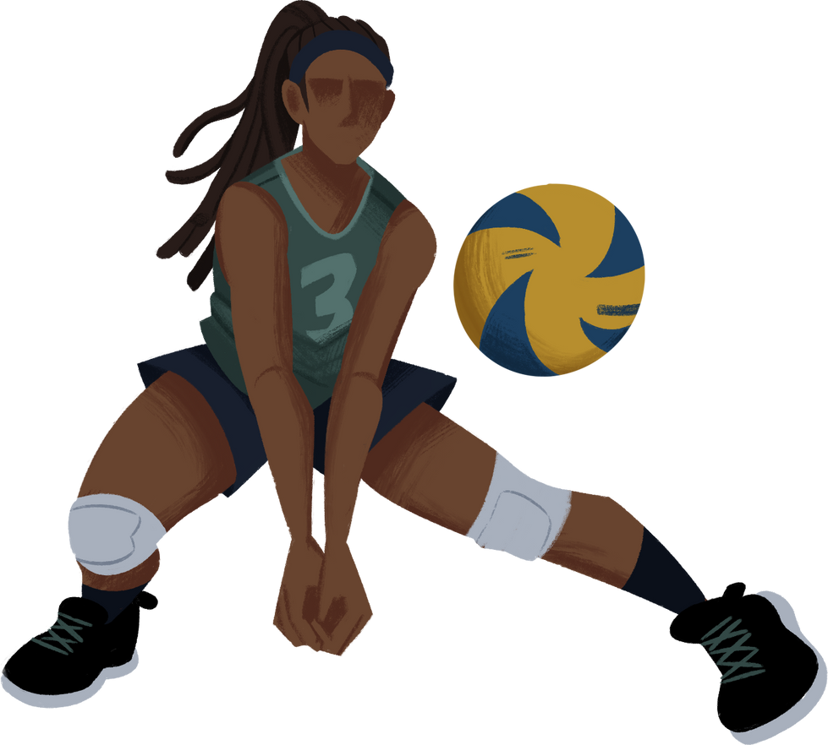
Knowledge – Skills –Competences
Knowledge | Skills | Competences
The concept of "safe space" in youth work | Creating an environment where young people feel protected, heard and valued | Supporting personal development within a framework based on trust and support
Elements of empathetic leadership in sport | Practicing empathy, active listening and emotional support in activities | Building a team culture based on respect, solidarity and equity
The role of common rules and values in sport | Establishing and implementing clear, inclusive and participatory norms | Strengthening an equitable and sustainable sports community

Slide 7
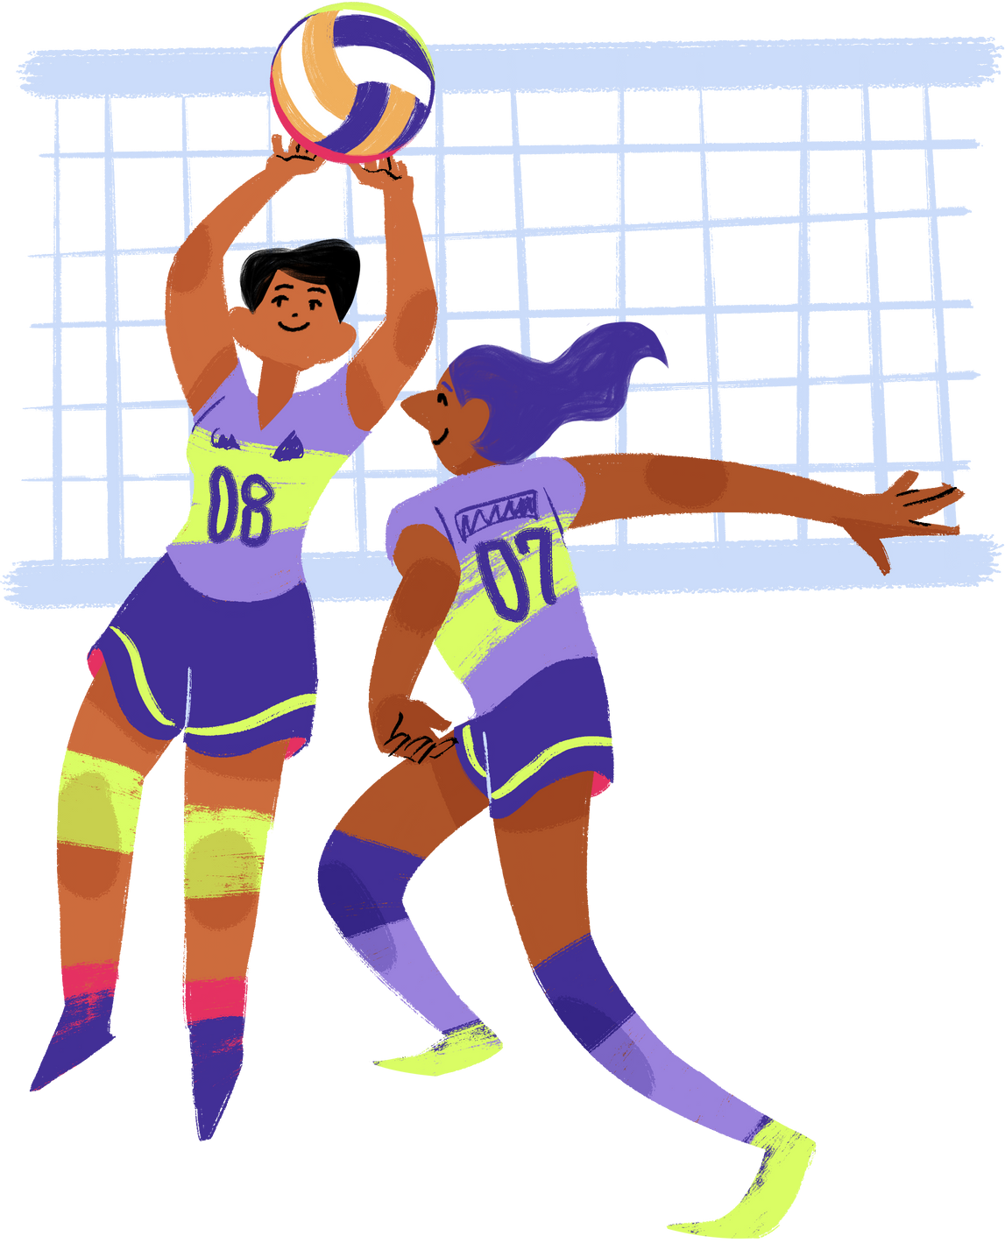
Interactive Moment
  Let’s make it a bit interactive — in the chat, please write one word that describes what inclusion in sport means to you.

Slide 8

CONCLUSION
  Module 3 helps coaches and youth workers use sport as a language of inclusion and understanding.
  It’s about building bridges between people — on and off the field.

Slide 9
“Funded by the European Union. Views and opinions expressed are however those of the author(s) only and do not necessarily reflect those of the European Union or the ANPCDEFP. Neither the European Union nor the ANPCDEFP can be held responsible for them”.

